Slide 1

Road Analytics Suite User Guide

Slide 2
Terms of Use
The World Bank takes will accept no liability for any decisions made that are based on the content of these analyses.
This is not a final product, and is provided to users on the basis that they will collaboratively work with the World Bank to refine and improve the analytics.
These analytics are designed by the World Bank’s Geospatial Operations Support Team (GOST). As such, they are not to be repurposed or sold for profit to third parties.
The World Bank retains the right to modify these analytics at any time via the GitHub repository mechanism. Use of these analytics implies consent to these Terms of Use.

Slide 3
Contents
Objectives
Overview
Installation
File Structure
Dashboard File
Poverty Score
Risk Score
Criticality Score
Roughness Score
PCS Score
RONET
Example Workflow
Troubleshooting

Slide 4
Glossary of Terms
RONET – Road analysis tool developed by Transport GP, World Bank
PCS – ‘Project Context Score’ – the single-number score denoting how important it is to maintain a given road.
Python – a computer programing language and interpreter application for code written in python
GitHub - https://github.com/ - a website that allows easy code sharing and version control for application developers
Command Shell – an interface allowing users to give commands directly to the computer itself. Also known as a command prompt.
IRI – International Roughness Index: a measure of road surface quality
QGIS – free geospatial software used to visualize data with a location component See http://www.qgis.org/en/site/
WKT – Well-known Text format – a simple way of recording location data. See https://en.wikipedia.org/wiki/Well-known_text

Slide 5
Objectives
This tool suite is designed to provide a spatial context score for road networks as stored in and downloaded from the ORMA system.
The objective of this tool system is to identify, from the spatial context of where the road asset is located, both relative to the overall local network and the physical / human environment, which roads are the best to keep well maintained.
This tool suite is currently in Beta version. Future versions will move the functionality onto the ORMA system.
We ask for your feedback and input in this trial phase so we can make these tools are relevant to you as possible. If they aren’t useful to you when making decisions, then we have failed. Tell us how to improve by emailing:
cfox1@worldbank.org
The analytics are designed to be modular. Within the constraints of the data we have, we can add or remove analytics as you see fit. Feel free to request new analyses.

Slide 6
Overview – the Dashboard
Currently, the tools are controlled from an excel document (dashboard.xlsm file). This file has two visible tabs:
PCS: here, the user will find a 5-sectioned page with 5 buttons. When activated, each button will run a certain analysis. These include:
Poverty Score: calculates the poverty level of the communes which the road serves
Risk Score: calculates the exposure of each road to natural disasters
Criticality Score: calculates which roads is most important to the network
Roughness Score: uses RoadLab Pro data to create a score for how rough the road is
Overall Context Score: weights the other scores based on user input to generate an overall score.
RONET: this page defines the default settings for input of the network file into RONET, and prepares the file for ingestion.

Slide 7
Overview – NetworK.Csv File
Each line in the Network.csv file represents a section of road, or a discrete road asset.
The position of the asset and any associated characteristics (‘attributes’, e.g. iri_med) can be visualized using geospatial software such as QGIS
We take this file as the starting point in our analysis as it should describe a local road network.
None of the analyses will run unless there is a Network.csv file in the location Runtime/<district>/ (see File Structure: Diagram)

Slide 8
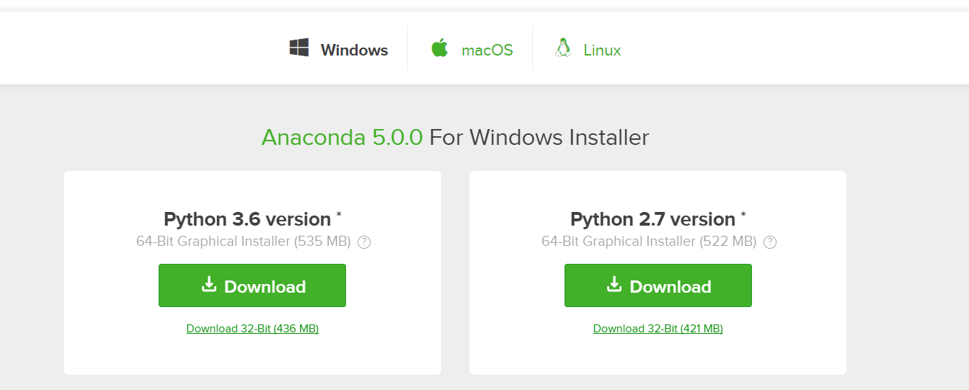
Installation - 1
Install Anaconda 2.7 from the following link: https://www.anaconda.com/download/ .
Ideally choose the 64-bit version if your machine is running a 64-bit version of Windows. If your computer is 32 bit, that will also work.
Follow the steps to install Python (https://www.python.org/) onto your computer, along with some key common packages.

Slide 9
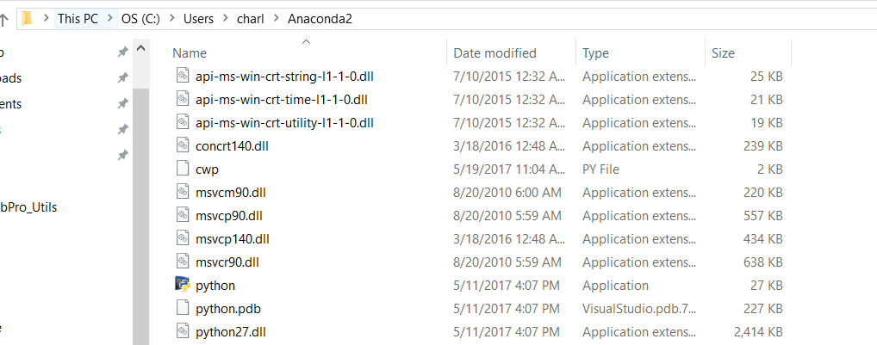
Installation - 2
Be sure to note the location of python.exe on your PC. Make a note of this file location.
This will look something like: “C:\Users\Bob\Anaconda2\python.exe”
This path will be referred to as <python location>
Con đường này sẽ được gọi là <python location>
!

Slide 10
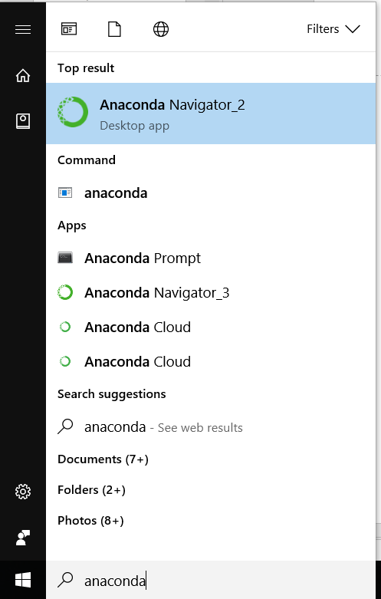
Installation - 3
Launch Anaconda Navigator

Slide 11
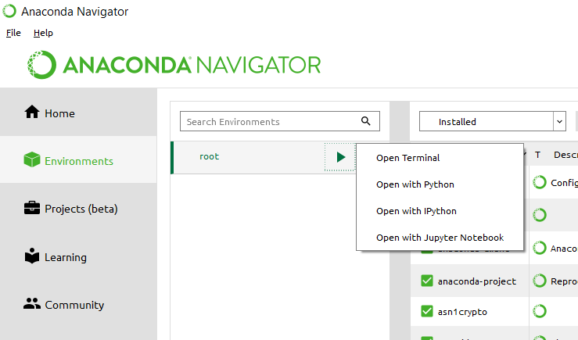
Installation - 4
From the environments tab, right click on the button to bring up the terminal menu. Select ‘Open Terminal’

Slide 12
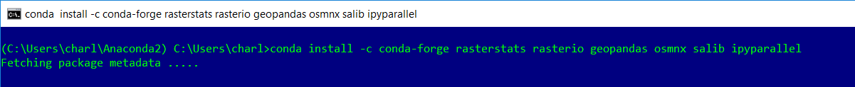
Installation - 5
With the terminal open, copy and paste the following line and press enter:
conda install -c conda-forge rasterstats rasterio geopandas osmnx salib ipyparallel
If done correctly, you will see a sign saying ‘Fetching Package metadata’
At the prompt, press ‘y’ then enter

Slide 13
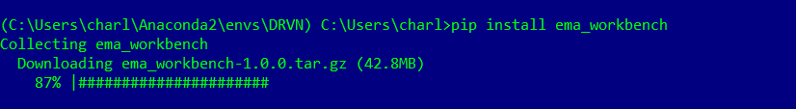
Installation - 6
Repeat Installation - 5, but this time entering the code:
pip install ema_workbench
If executed correctly, on the second attempt, it will say ‘requirement already satisfied’
Close all windows. Your python environment is now set up. Ensure that you have written down your python path as per Installation - 2

Slide 14
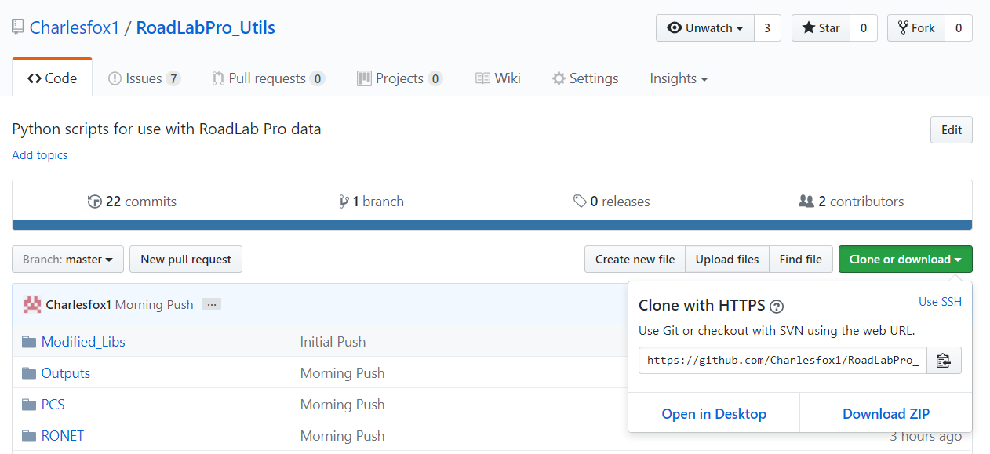
Installation - 7
Make an account at GitHub. Then, navigate to: https://github.com/Charlesfox1/RoadLabPro_Utils
Click ‘Clone or Download’ and then ‘Download ZIP’

Slide 15
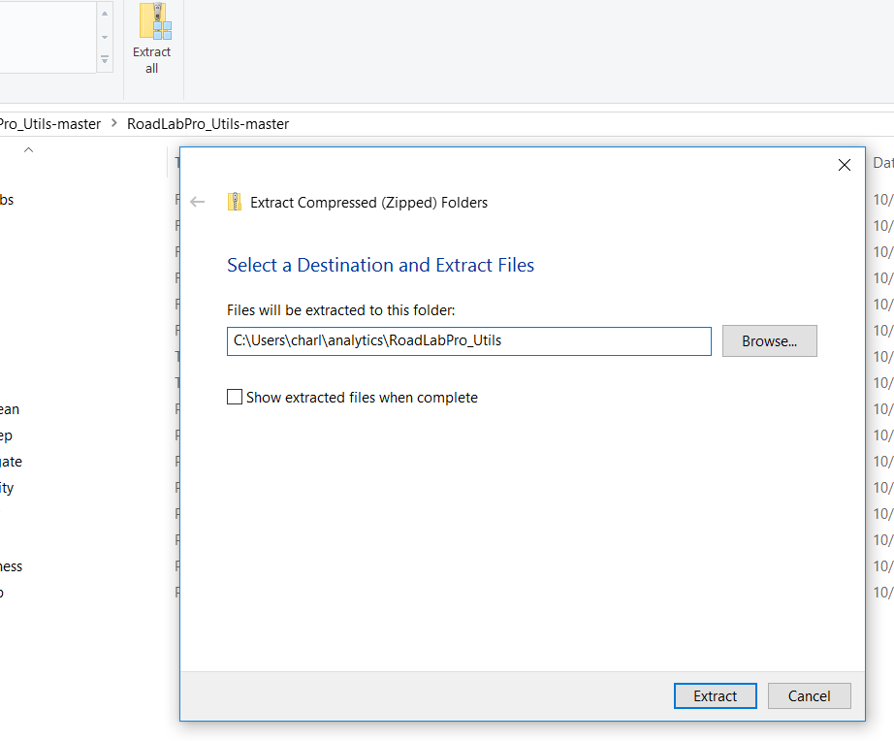
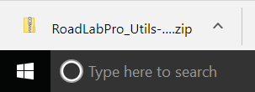
Installation - 8
At this stage you should see the .zip file in your download bar. Unzip the zip folder to a location on your PC. Make a note of this location
This path will be referred to as <clone location>
Con đường này sẽ được gọi là <clone location>
!

Slide 16
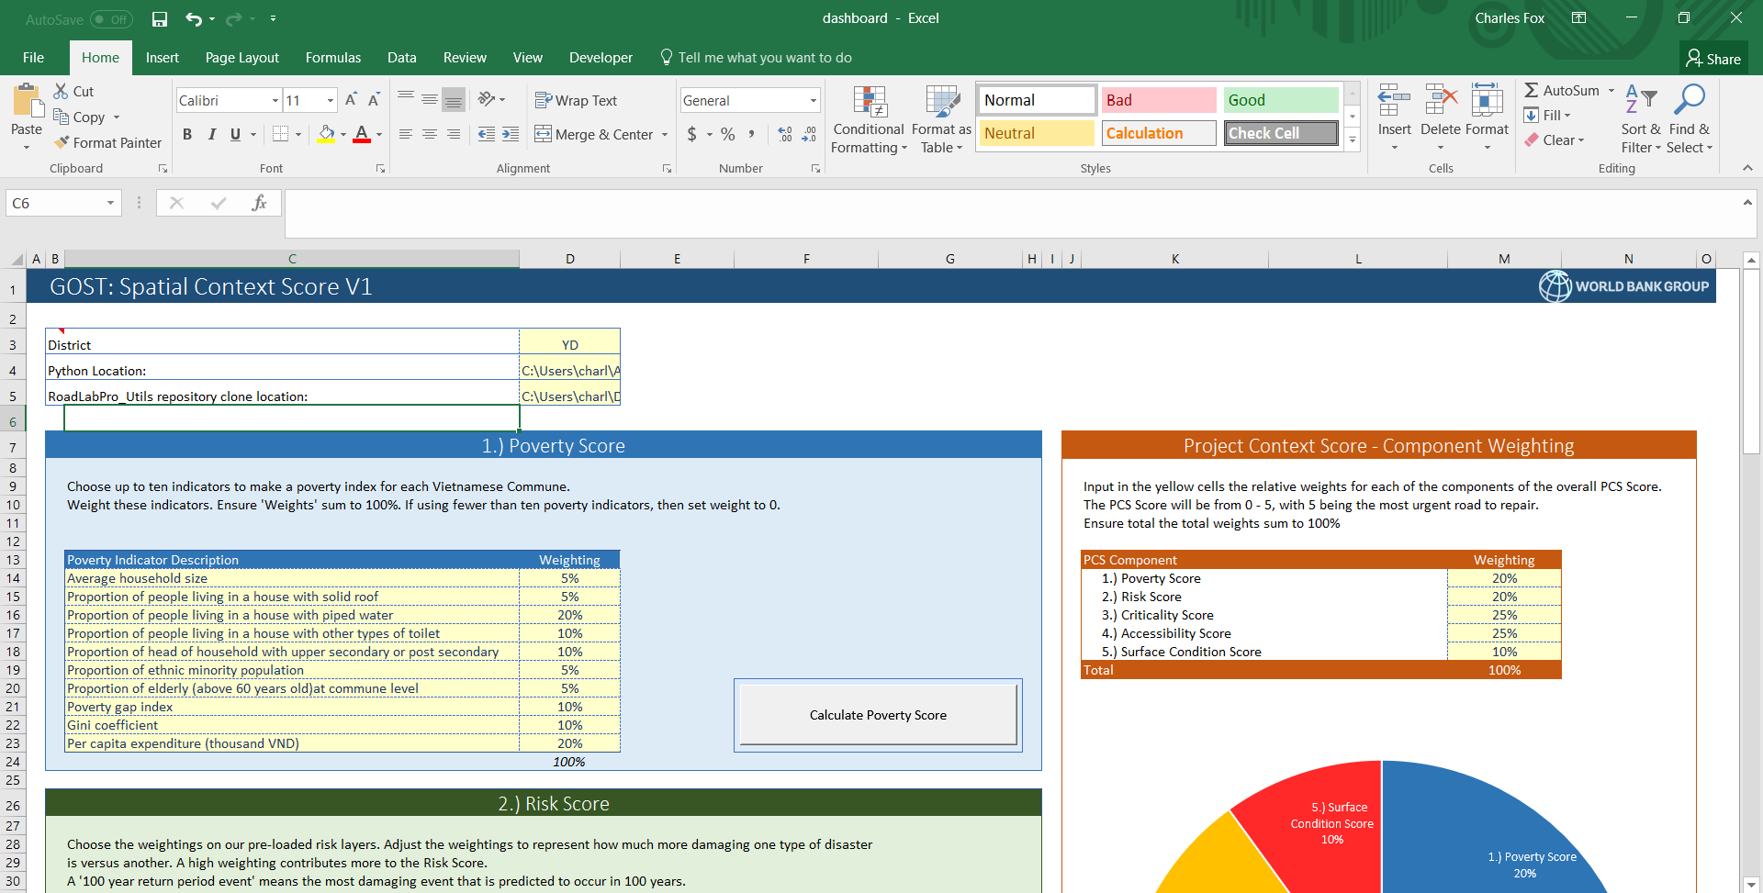
Installation - 9
Once everything has been extracted to your destination file folder, open the dashboard .xlsm in:
<clone location>\PCS\dashboard.xlsm

Slide 17
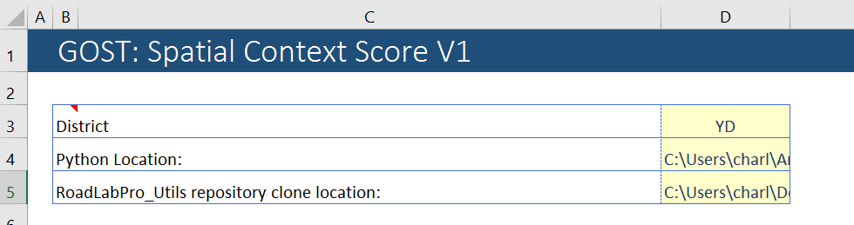
Installation - 10
Copy and paste the <python location> to cell D4
Copy and paste the <clone location> to cell D5
Place <clone location> here
Địa chỉ <clone location> đây
!
Place <python location> here
Địa chỉ <python location> đây
!

Slide 18
File Structure: Key Points I
The file structure of the analytics module should not be changed.
Do not:
Delete any existing folders
Change the relative position of the current folders in the hierarchy e.g. by placing the ‘PCS’ folder inside the ‘runtime’ folder.
‘Runtime’ folder includes key inputs and log files generated by the analytics, organized by district / province.
‘Outputs’ folder contains the outputs of each analysis, organized by district / province.
‘PCS’ folder will contain the data required to run the analytics, and is split up by analysis type.
For example, there is a ‘poverty’ sub folder which is only called when running the poverty script.
‘RONET’ folder will contain the output of the RONET preparation script. User will also have to place a RONET file into each folder. See RONET for more details.

Slide 19
File Structure: Key Points II
‘Setup’ folder contains a clone of the Anaconda environment. End users should not need to go into this folder.
‘Modified Libs’ folder contains the modified python libraries for use with the Network Cleaning scripts. End users should not need to go into this folder.
‘Documentation’ folder contains documentation on how to run the analytics.

Slide 20
File Structure: Data Preparation
The analytics run at the district or province level, depending on what was downloaded from ORMA.
For each district or province network where you wish to run the analysis, you will have to:
Create a sub-folder in the ‘Runtime’ folder with the name of the province. This MUST contain a file called ‘Network.csv’ for the analytics to correctly find the road network in the region. Download this file from the ORMA system, and rename it ‘Network.csv’ as required.
After running the RONET preparation tool from the RONET tab of the dashboard, copy to the newly created folder a version of the RONET excel document.
Currently, data from Yen Dinh (YD) and Thach Thanh (TT) will be downloaded with the tool suite. It is recommended that you abbreviate the name of the district when running the platform to help keep file paths short.

Slide 21
File Structure: Diagram
Lvl 0
<clone location>
Level 1
PCS
RONET
Runtime
Outputs
Documentation
Modified Libs
Setup
Level 2
Adm_boundaries
District 1
District 1
District 1
Road Analytics Suite User Guide.pptx
Centerline
Anaconda_env.yml
Criticality
District 2
District 2
District 2
Shapely
Hazard
. . .
. . .
. . .
Poverty
dashboard.xlsm
District n
District n
District n
Level 3
RONET_n.xlsm
Network.csv
Criticality_output
See File Structure: Diagram (PCS)
Prepared_n
PCS_Criticality_log
Risk_output
PCS_Risk_log
Poverty_output
Legend
PCS_Poverty_log
Roughness_output
Existing file
PCS_Roughness_log
PCS
<name>
<name>
Input file
RONET_log
<name>
Generated file
<name>
Logging file
<name>
Folder
<name>
Setup folder

Slide 22
File Structure: Diagram (PCS)
Lvl 0
PCS
Level 2
Adm_boundaries
Criticality
Hazard
Poverty
dashboard.xlsm
Level 3
VNM_adm0.shp
Network Lib
pov_layer.shp
Runtime
Input
Runtime
HazardData
Poverty_Communes_2009.shp
Level 4
District 1
District 1
District 1
Coastal Flood
District 2
District 2
District 2
Earthquake
. . .
. . .
. . .
. . .
Legend
District n
District n
District n
Wildfires
<name>
Existing file
Level 5
log files
<Origin_1>.shp
log files
<hazard_1>.tif
<name>
Input file
<Origin_2>.shp
<hazard_2>.tif
<name>
Generated file
. . .
. . .
<name>
Logging file
<name>
Folder
<Origin_n>.shp
<hazard_n>.tif
<name>
Setup folder

Slide 23
Dashboard File - Overview
The dashboard file is your control panel for the powerful python-based analyses that sit within this suite of tools.
All of the analysis can be done by configuring the PCS and RONET pages, and then pressing the associated macro buttons. The analysis is not done in excel, but rather by Python, but launched from this file using conventional Excel macros.
The user should never move the dashboard file. This is because the various programs expect to find the dashboard.xlsm file in its current position relative to other files and data resources (see file structure diagram for illustration).
The dashboard has two tabs: PCS and RONET. The PCS tab calculates the Project Context Score, whilst the RONET tab prepares the input Network.csv file for easy portability to RONET.

Slide 24
Dashboard File - Overview
PCS: on this tab the user will find a 5-sectioned page with 5 buttons (see layout). When activated, each button will run a discrete analysis. These include:
Poverty Score: calculates the poverty level of the communes which the road serves
Risk Score: calculates the exposure of each road to natural disasters
Criticality Score: calculates which roads is most important to the network
Roughness Score: uses RoadLab Pro data to create a score for how rough the road is
Project Context Score (PCS): weights the other four scores based on user input to generate an overall score.
RONET: on the tab the user defines the default settings for input of the Network.csv file into RONET, and prepares the file for ingestion.

Slide 25
Dashboard File – PCS Layout
Poverty Score
PCS Aggregation
Risk Score
Criticality Score
Roughness Score
Citations

Slide 26
Poverty Score - 1
The Poverty Score is calculated by intersecting each road in the Network.csv with a poverty layer
This poverty layer is generated by the user based on the data contained in the Poverty_Communes_2009.shp file.
the poverty data is for the year 2009
If better / more complete data can be found, this file can be changed.
Any replacement files need to cover all of Vietnam, and have a coordinate reference system of WGS 1984 / epsg 4326.
The file type is a shapefile (.shp)

Slide 27
Poverty Score - 3
The poverty score control panel allows the user to make their own Poverty Index, and weight each selection accordingly.
Currently, the platform allows for 10 variables to selected from a total dataset of 35 variables at any one time to make a poverty index.
Fewer than 10 variables can be selected if desired. The user must:
delete the contents of the cells,
set the weight to 0 / delete the value in the weighting column
The weighting on all factors MUST sum to 1.
Pressing the ‘calculate poverty score’ button will start the analysis for the district / province specified in cell D3

Slide 28
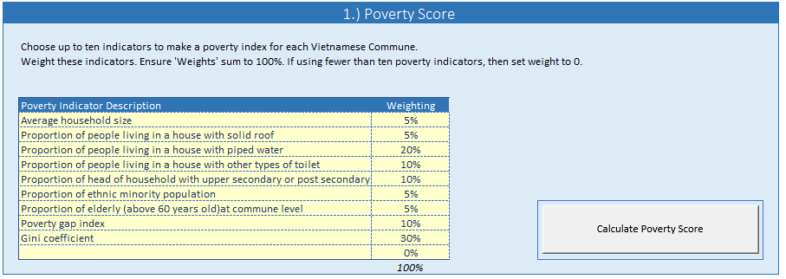
Poverty Score - 4
A = select criteria from drop down menus
B = weighting for each criteria. Must sum to 100%
C = run analysis button
A
B
C

Slide 29
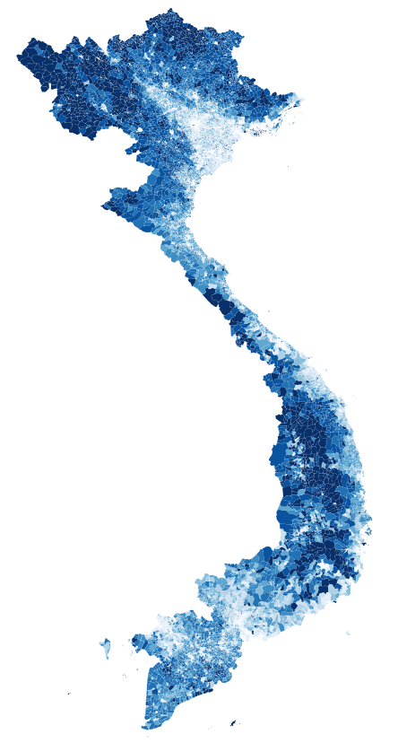
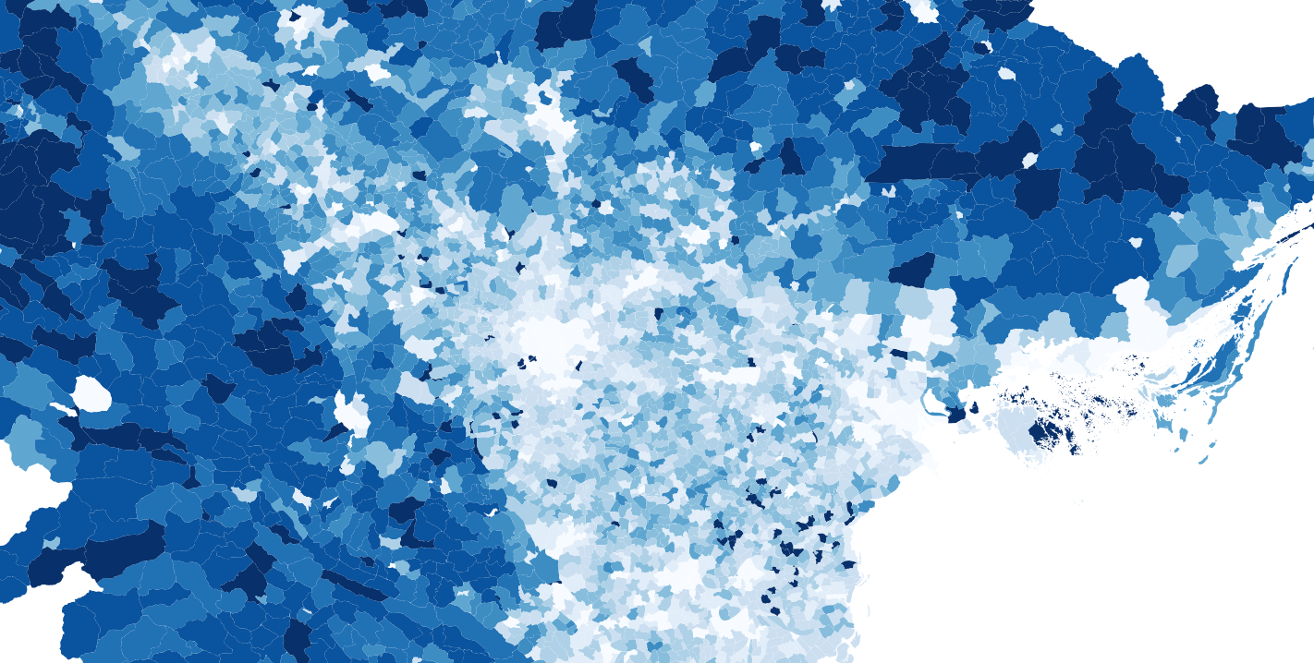

Poverty Score - 5
The analysis generates a poverty layer with information at the commune level at runtime
This layer can be found at “PCS/Poverty/Pov_layer.shp” and can be visualized per the below in QGIS:

Slide 30
Poverty Score - 6
The Output of the analysis is a copy of the Network.csv file with a new column: ‘POV_SCORE’ for each road.
This is the average value of the Poverty Index which each road intersects, normalized from 0 to 1 for that road network.
A road with a POV_SCORE of 1 implies it goes through districts with the highest poverty for that local network
A road with a POV_SCORE of 0 implies it goes through districts with the lowest poverty for that local network
The output can be found at: Outputs/<district name>/poverty_output.csv
Re-running the analysis will overwrite this file.

Slide 31
Risk Score

Slide 32
Criticality Score

Slide 33
Roughness Score

Slide 34
PCS Score

Slide 35
RONET
The dashboard

Slide 36
Example Workflow

Slide 37
Troubleshooting
It is highly likely that at some point you will experience errors whilst using the tool suite as it is in Beta testing phase.
Under the Runtime folder, there will be log files for each analysis.
These include information that will help us to fix any errors remotely.
Post any issues you encounter to https://github.com/Charlesfox1/RoadLabPro_Utils/issues along with:
The Network.csv file being analyzed;
The log file for analysis that failed;
A description of the error you encountered.
The team will then endeavor to solve the problem and provide a solution.
Please note, this may require you having to replace any of the key files with a new version, which we will keep up to date and live at this GitHub location.

